Slide 1

The Power of Encoding and Decoding
Explore the fundamental concepts behind encoders and decoders, powerful tools that transform and transmit digital data in modern electronics.
Farjan Ahmmed
ID: 232-35-738

Slide 2
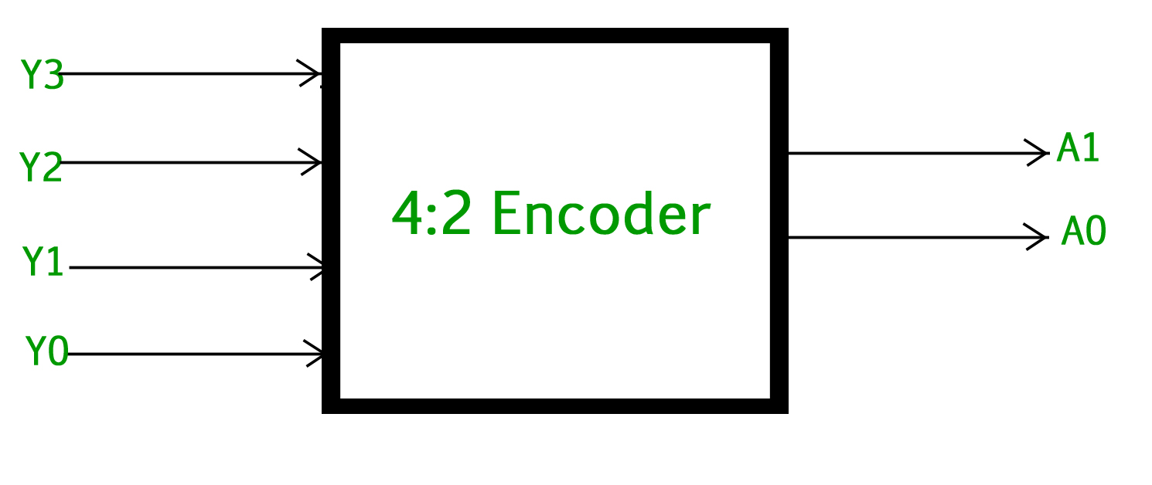
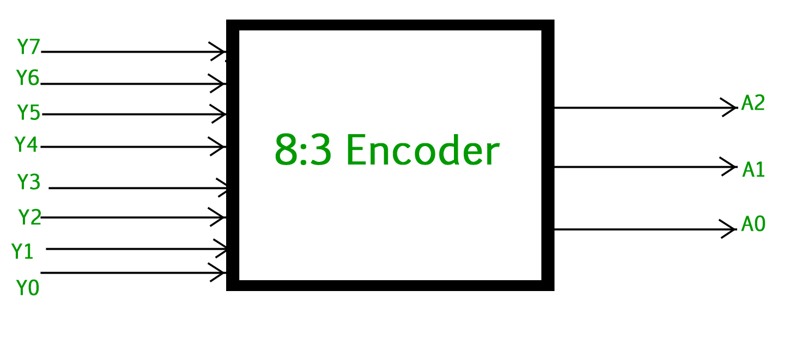
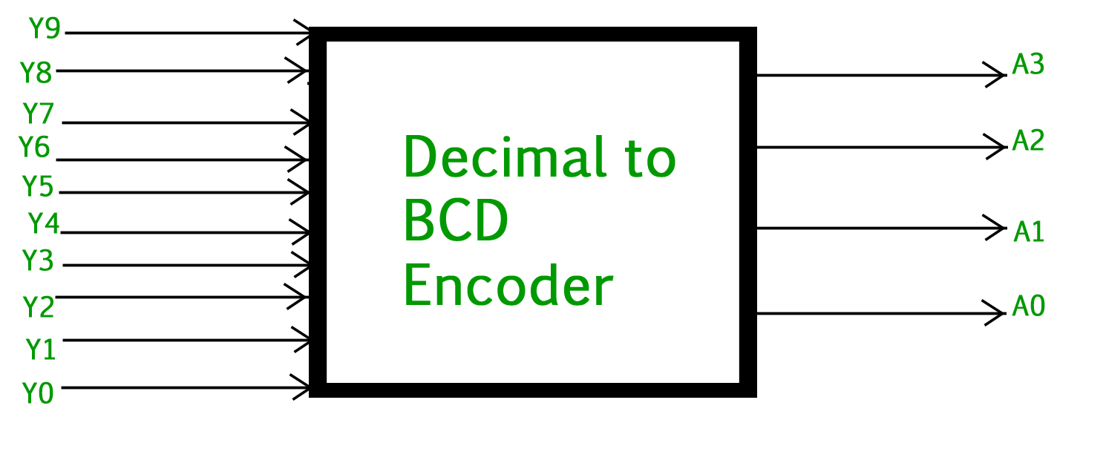
Encoders : Compressing Information
4 to 2 Encoder
Priority-Based
Consists of four inputs Y3, Y2, Y1 & Y0 and two outputs A1 & A0
Encodes the highest priority active input, even with multiple active.
Octal to Binary
Specializes in converting 8 inputs into a 3-bit binary output.
Decimal to BCD Encoder
Converts a decimal input into its corresponding 4-bit (BCD) representation.

Slide 3

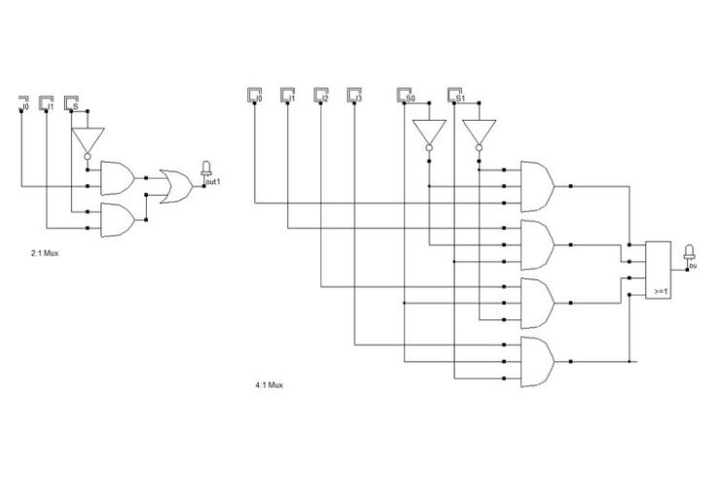

Applications of Encoders
Keyboard Encoding
Digital Multiplexing
Data Compression
Converts key presses into unique binary codes for computers.
Combines multiple signals onto a single transmission line.
Reduces the number of bits required to represent information.

Slide 4
Decoders : Expanding Binary
1
Binary to Decimal
Converts binary inputs to one of ten decimal outputs.
2
BCD to 7-Segment
Powers digital displays by mapping BCD to segment controls.
3
Demultiplexing
Distributes a single input across multiple outputs based on selectors.

Slide 5



Decoding Applications
Display Systems
Memory Addressing
Data Distribution
Decoders drive screens, panels and other digital outputs.
Decoders select specific memory locations for data retrieval.
Decoders route signals to the appropriate destinations.

Slide 6

Implementation Challenges
1
Handling Ambiguity
2
Error Detection
Ensuring only one input is active at a time in simple encoders.
Implementing schemes to identify and correct encoding/decoding issues.
3
Hardware Complexity
Balancing performance, cost and size in complex digital systems.

Slide 7

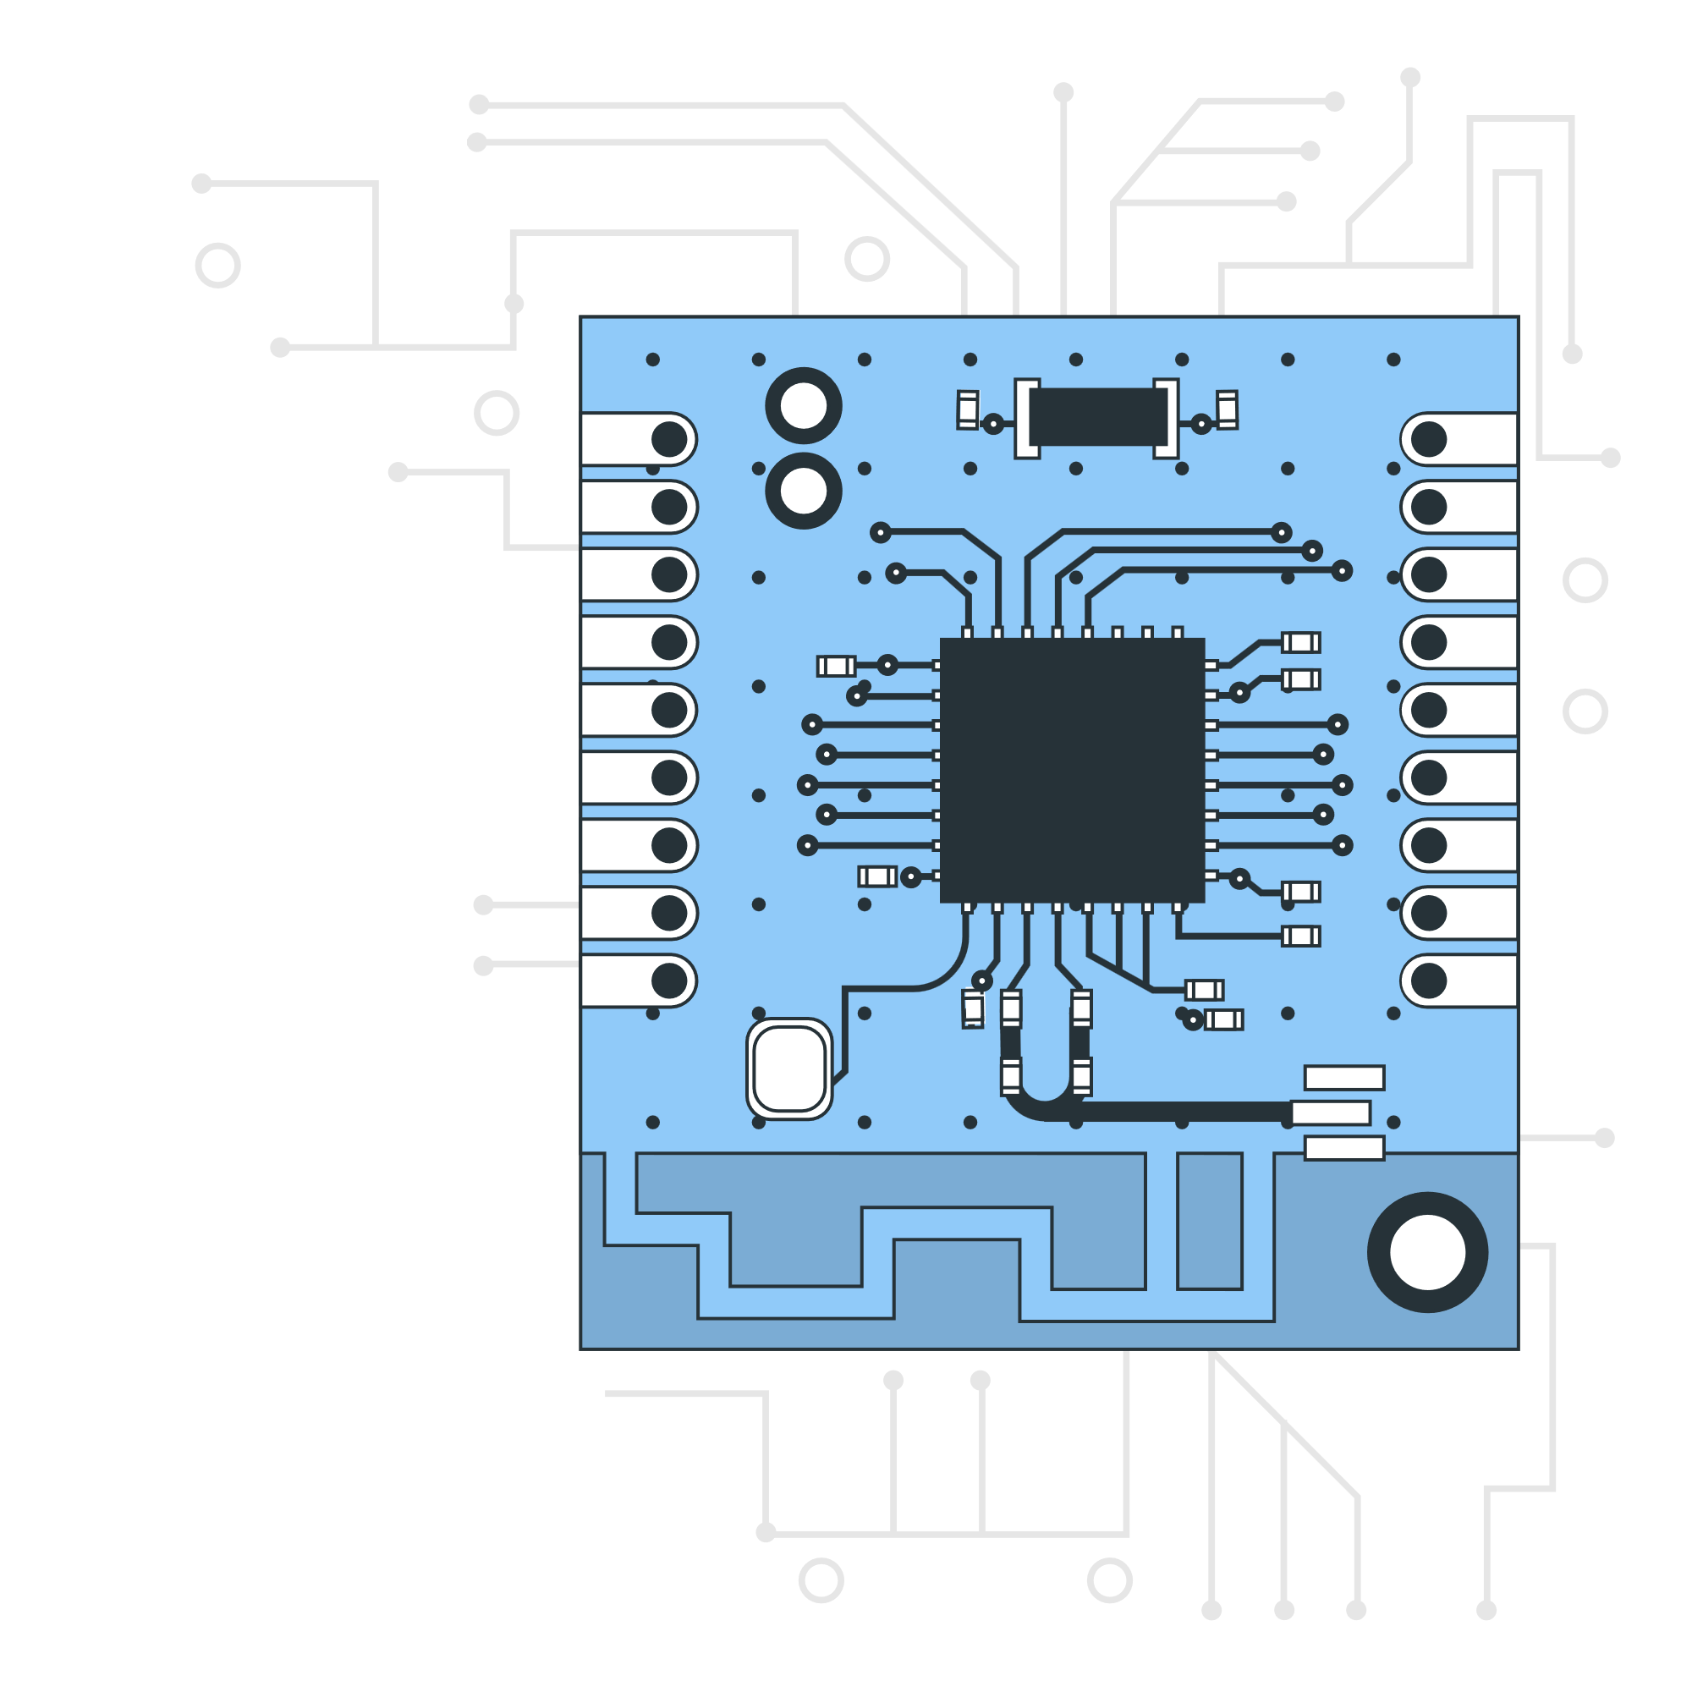


A Real-World Example
Transmitter
4-to-2 encoder compresses signals for transmission.
Channel
Fewer wires simplify the hardware and reduce costs.
Receiver
2-to-4 decoder expands the compressed signals back to original form.

Slide 8



The Future of Encoding/Decoding
Increased
Integration
Improved Error
Handling
Performance Enhancements
Encoders and decoders becoming core components of digital systems.
Advanced techniques to detect and correct encoding/decoding issues.
Faster, more efficient encoders and decoders for real-time applications.

Slide 9

Conclusion
Encoders and decoders are essential in digital systems
They enable efficient data compression, transmission, and retrieval
Continued innovation will lead to more robust and capable designs
Practical challenges like error handling remain an active area of research

Slide 10
Thank You

